Slide 1
The Problem: Suffering
The Answer: ?

Slide 2

Notes:
https://plus.google.com/+ChloeJeffreys1/posts

Slide 3

Notes:
https://www.google.com/url?sa=i&rct=j&q=&esrc=s&source=images&cd=&ved=0ahUKEwjE5Lzx9ffLAhXIm4MKHd71BdsQjxwIAw&url=http%3A%2F%2Fthecommunityuae.com%2Fchild-cancer-awareness%2F&psig=AFQjCNFqBFSEmzd-akGUzXClanoCqSYK-g&ust=1459960182614930

Slide 4
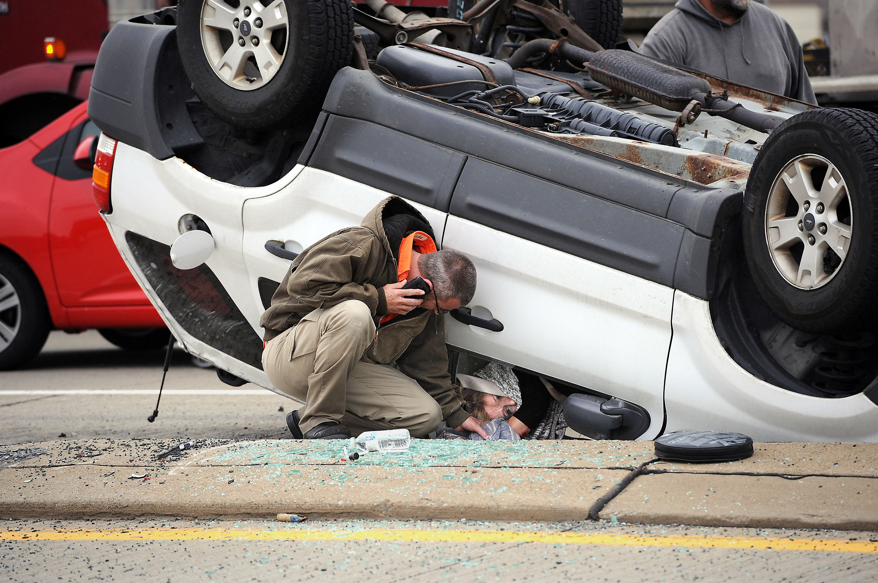

Slide 5
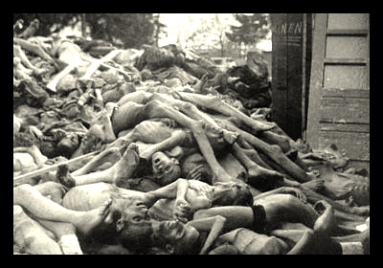

Slide 6


Slide 7
Notes:
http://www.luggageonline.com/lolnews/girl-lost-2004-tsunami-reunited-family/

Slide 8
Livingston Types of theodicies:
Theodicy of Mystical Participation
A Future, This-Worldly Theodicy
C. Other-worldly Theodicy
D. Dualist Theodicy
E. Karma-Samsara Theodicy
F. Monotheistic Theodicies [next slide]

Slide 9
Livingston Types of theodicies:
Theodicy of Mystical Participation
A Future, This-Worldly Theodicy
C. Other-worldly Theodicy
D. Dualist Theodicy
E. Karma-Samsara Theodicy
F. Monotheistic Theodicies [next slide]
Labor & birth
Child dying of cancer
Car accident
Genocide
Tsunami

Slide 10
F. Monothestic Theodicies
I. Suffering as Recompense for Sin
II. Suffering as a Test and as a Necessary Condition of “Soul-Making”
III. A Theodicy of Submission: The Mystery of God’s Sovereignty
IV. A Theodicy of Protest
V. The Free Will Defense
VI. Process Theodicy
Labor & birth
Child dying of cancer
Car accident
Genocide
Tsunami

Slide 11
Notes:
http://www.trinity.edu/mbrown/whatisreligion/PDF%20readings/Gray%20&%20Wegner-Blaming%20God%20for%20our%20Pain.pdf

Slide 13
Notes:
“ The scenario concerned the Millers, a family picnicking in a remote valley when suddenly the water level rises. Participants were told either that the cause of the water was unknown or that it was caused by a malevolent dam worker upstream. They were also told that the water either drowns the whole family (including the family dog) or simply ruins their lunch. “http://www.trinity.edu/mbrown/whatisreligion/PDF%20readings/Gray%20&%20Wegner-Blaming%20God%20for%20our%20Pain.pdf (p. 12)

Slide 14
“Any Christian who disagrees that God is in charge will come to complete agreement with biblical teaching when caught in a thunderstorm! Sitting in a comfortable chair on a calm day, it is easy to say that God has nothing to do with natural disasters, but when it is your wife and daughter who are being swept away in a flood; when it is your house that is shaking during an earthquake—when that happens and you cry out to God for protection, you then prove you believe that God is in charge after all!”
Many people assume that Allah only punishes people when they commit injustices towards others, yet Muslims must refrain from being so self-absorbed; Allah created mankind so that they may worship Him in line with His monotheistic nature, and deviancy from such a clear purpose only serves to anger the Most High. It is true that Japan is not like the US or many of its allies in that it refrains from waging direct war against others, yet their failure was the lack of submission to Allah and refusing to admit that all of the favours they are blessed with are given to them by their Creator. …..Despite the luxurious lives they live, as a community they have never thanked Allah by submitting to him.
Denying the Lordship of Allah and refusing to submit to Him in worship is the biggest act of injustice….
Notes:
http://www.moodymedia.org/articles/god-and-natural-disasters/
http://www.islam21c.com/islamic-thought/2387-reasons-behind-the-japanese-tsunami/

Slide 15
When disasters occur around the world, it is common to hear people who come from the Christian tradition asking why such a thing could occur -- how could God let something like the earthquake and tsunami happen?
But that isn't a question asked by adherents of eastern religions such as Buddhism and Shinto. For them, what caused the disaster isn't the important thing. What's important is to be positive, affirming and persistent in the face of adversity.
"Natural tragedies are part of living on the planet," says Fredrich Ulrich, senseiof the Manitoba Buddhist Temple. "Its geology and geography make such recurring tragedies inevitable. There is no need to think we have been targeted by a god of some sort."
What's important, he says, is how people respond to tragedies such as the earthquake and tsunami.
Notes:
http://www.buddhistchannel.tv/index.php?id=44,10031,0,0,1,0#.VwP8-fkrK70

